Slide 1
Employee Data Analysis using Excel
STUDENT NAME: SUMAN G
REGISTER NO: 312215939, D4085ADEBBEE5A8A5504F9343FDDDB55
DEPARTMENT: B.COM
COLLEGE: SHRI SHANKARLAL SUNDARBAI SHASUN JAIN COLLEGE FOR WOMEN

Slide 2
PROJECT TITLE
Employee Performance Analysis using Excel

Slide 3


AGENDA
Problem Statement
Project Overview
End Users
Our Solution and Proposition
Dataset Description
Modelling Approach
Results and Discussion
Conclusion
3/21/2024 Annual Review

Slide 4

PROBLEM STATEMENT
A well-defined PROBLEM STATEMENT is one of the key element of a rigorously designed research project.
It is based on your literature review and informs your study design a manner that facilitates the creation of a proposed solution through the data analysis.
An effective problem statement includes evidence to support any unbiased claims.
It demonstrate the scope of the problem such as the loss It’s causing, a decrease in activity, staff attribution or other specific and measurable problems it is causing.

Slide 5
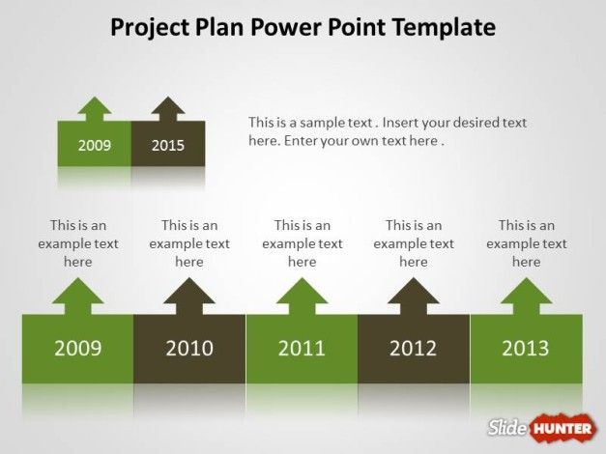

PROJECT OVERVIEW
Provide context for the analysis.
Outline of the employees data.
Graphical representation of the performance level.
Exit dates have been filtered.
Ratings shown in the form of pivot table.

Slide 6

WHO ARE THE END USERS?
END USERS ARE THE PEOPLE OF THE COMPANY.
THE PEOPLE CAN ACCESS THEIR DATA EASILY .
IT HAS ALL THE INFORMATION THAT THEY NEED IN DAILY ROUTINE.
THE PURPOSE OF ANALYTICS IS TO MAKE INTELLIGENT INSIGHTS FROM THE DATA GENERATED, TO PUT INTO ACTIONABLE USE.
EMPLOYEE’S DATA IS VERY HELPFUL IF IT IS ALREADY EXTRACTED AND FILTERED.

Slide 7

OUR SOLUTION AND ITS VALUE PROPOSITION
CONDITIONAL FORMATTING – MISSING.
FILTER – REMOVE AND FILL COLOR IN NULL CELLS.
FORMULA – PERFORMANCE LEVEL, CURRENT EMPLOYEE RATING.,
PIVOT – EMPLOYEE DATA
GRAPH – NO. OF EMPLOYEES, EMPLOYEE TYPE.

Slide 8
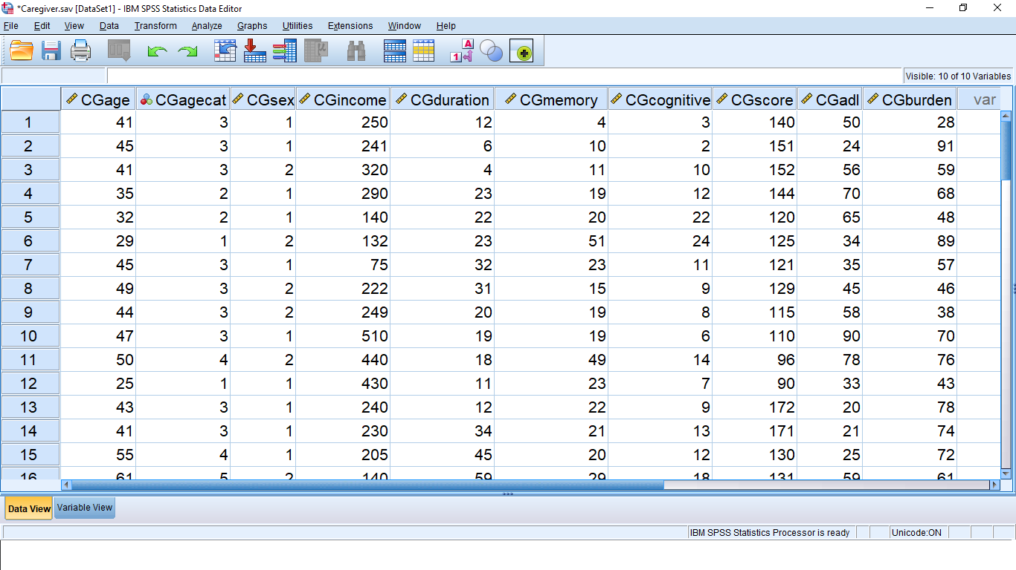
Dataset Description
EMPLOYEE DATA SET- KAGGLE
26 FEATURES
9 FEATURES
EMPLOYEES ID – Number
NAME – Text
EMPLOYEE TYPE – Part time or Full time
Performance level – Ratings
Gender – Male or Female

Slide 9

THE "WOW" IN OUR SOLUTION
The formula for PERFORMANCE RATING as PERFORMANCE LEVEL
(=IFS(Z2>=5,”VERY HIGH”,Z2>=4,”HIGH”,Z2>3,”MEDIUM”,TRUE,”LOW”)
Conditional formatting and filter the data
Graphical representation of the Employees data
9

Slide 10
Modelling
1. DATA COLLECTION
The data has been collected from KAGGLE.
2. FEATRURE COLLECTION
The listed 10 features were taken for the analysis of data.
3. DATA COLLECTION
Identifying the missing values.
Filtering of those missing values.
4. CALCUATION OF PERFORMACE LEVEL
By considering the current employee rating. I found the performance level using the formula.
5. SUMMARY OF THE PIVOT TABLE
Segregating of certain features of row, columns, heading and so on.
10

Slide 11
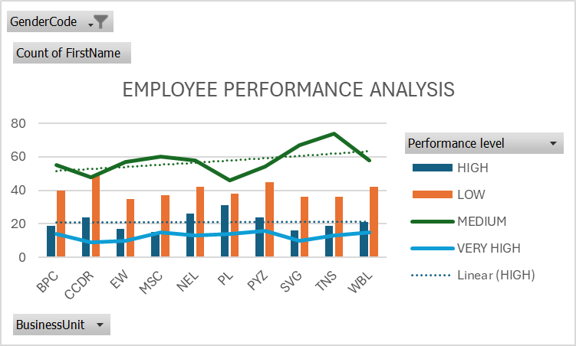
RESULTS
11

Slide 12

CONCLUSION
Hence, the data performance analysis is very useful for the employees.
It is used to get the information easily.
It is easy to access.
It is easy to understand.
Helpful for the management to know about the employees immediately.

